Slide 1

Arista Networks Department of Engineering, Computing, and Cybersecurity
Team Members: Bryanna Parkoff, Garrett Stokes, and Ruby Rodriguez
Professor: Dr. Gonzalo D. Parra

Slide 2
Outline
Project Management
Abstract
Milestone 1: Arista Networks Mission & Vision
Milestone 2: Culture & Values
Milestone 3: Business Integrity & Code of Ethics
Milestone 4: Cybersecurity 101 Trainings
Deliverable 1: Ethics & Security Compliance Policies
Deliverable 2: Device Hardening
Deliverable 3: Vulnerability Management: Assessing Risk & Treating It
Deliverable 4: Taking Security Measurements
Professional Accomplishments
References

Slide 3
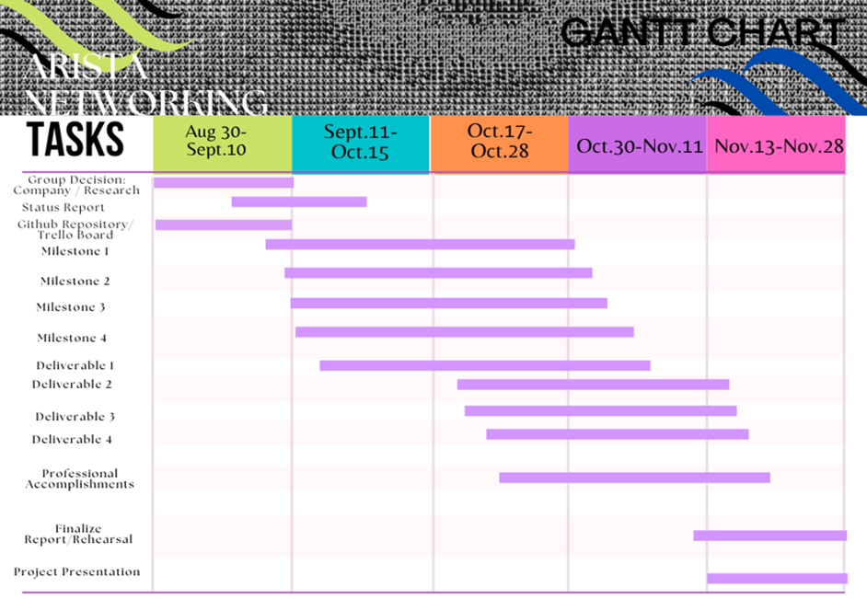
Project Management
Our project has been open sourced through the following GitHub Link:
https://github.com/bparkoff-arch/AristaNetworks
Trello Management Link:
F22-BP-GS-RR-AristaNetworks |Trello

Slide 4

Abstract
Arista Networks is a computer networking industry-leading company, contributing client to cloud networking for large data centers, campus, and routing. We choose this company because it proved to be a transparent company meaning it provided us with tons of information simplifying our research and it's recognized as a leader with the top score in current offering and strategy categories in The Forrester Wave™: Open, Programmable Switches For A Business wide SDN, Q3 2020 due to the great respected leaders that keep enriching their network platforms and innovations.
In this presentation we shall dive into what makes up this titan company which are: it's mission, vision, core values, code of ethics, policies, and security operations.

Slide 5
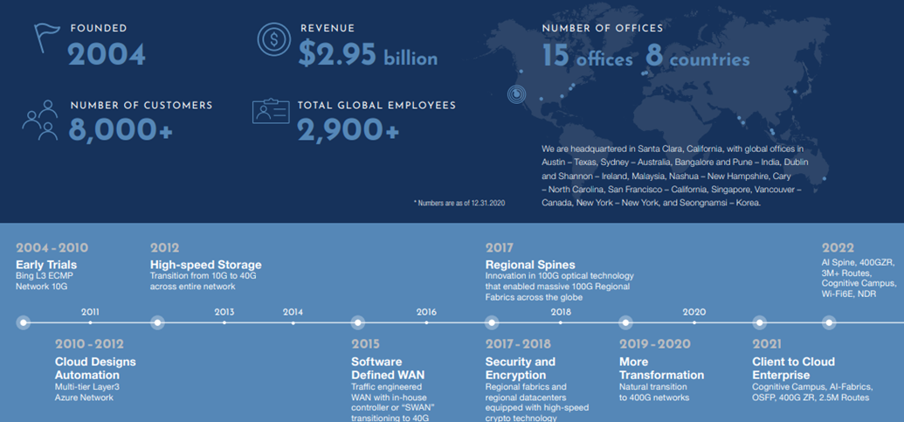
Milestone 1: About Arista's Mission & Vision
Mission: “We are committed to designing, manufacturing and delivering leading data-driven cloud networking solutions in an environmentally and socially sustainable manner."
Vision: “To drive for customer success in every aspect of what we do. We build and deliver innovative, high-quality products and services through commitment, innovation, and uncompromising focus on customer needs.”

Slide 6
Milestone 2: Company Culture
Companies tend to change their culture and values constantly but, not so at Arista. The following are the top 10 ways Arista forms its culture and works with its diverse team:
1.Drive for customer success in every aspect: support, quality, innovation, and experience
2.Do the right thing be it for products, quality, customers, and daily interactions
3.Challenge status quo, question traditional habits and be cost-effective
4.Develop alternative ways of achieving disruptive innovation in every function, preserving quality
5.Develop agile and mobile teams that can respond to priorities (as opposed to fixed or top-down organizations)
6.Maintain the highest level of integrity in conduct
7.Discuss, debate but quickly align to priorities
8.Treat your peers, vendors, customers with respect and develop a win-win partnership
9.Mentor individuals and develop teams for overall success, not persona, success
10.Cultivate Arista pride but never ego or arrogance in our culture

Slide 7

Milestone 2: Company Core Values
Arista's top three core values are: environment, social responsibility, and governance.
1. Environment: implemented an Environmental Management System (EMS) that lays out objectives for achieving pollution prevention, environmental protection and monitoring and continuously improve the environment operations of their technologies.
Don't manufacture in-house products instead contract 14001 ISO certified manufacturers aiming to integrate sustainability into their product's life cycle and reduce hazardous materials without degrading the product performance.

Slide 8
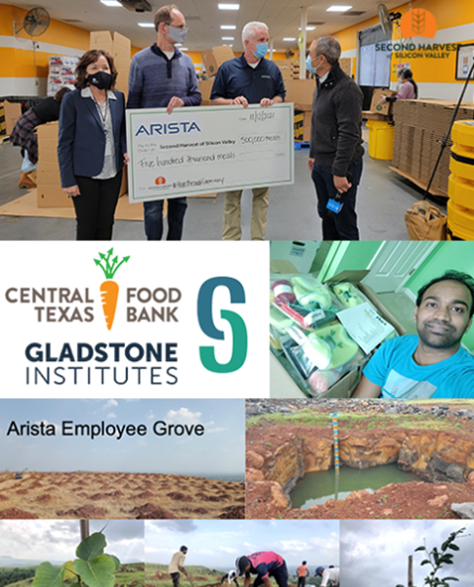
Milestone 2: Company Core Values
2. Social Responsibility: celebrates their employees—who strive to differentiate by supporting a fun and inclusive culture that supports every member of the team regardless of background.
Respect, integrity, innovation, passion, pride, and trust are all social core values valued by Arista’s teams.
Encourage community engagement and partnership giving generously to numerous deserving non-profit organizations dedicated to developing impactful solutions to hunger, children’s education and wellness, health, and environmental sustainability issues.

Slide 9

Milestone 2: Company Core Values
3.Governance: Arista believes that good governance leads to high board effectiveness, promotes the long-term interests of their shareholders, strengthens the accountability of the board of directors and management, and improves them standing as a trusted member of the community they served.
They have high standards and policies to provide oversight of their strategic, financial, technical and organizational goals.

Slide 10
Milestone 3: Business Integrity & Code of Ethics
Business Integrity: Arista’s success is built on a foundation of integrity, ethical business conduct, and always doing the right thing. This means adhering to the highest ethical principles in conducting our business and avoiding any activity that involves even the appearance of impropriety. You, as one of Arista’s valued business partners, have a critical role in protecting the trust which investors, customers, colleagues, governments, and the global business community place in Arista. Any violation of this Code will result in action up to and including termination of your status as an Arista business partner.
Arista's Code of Ethics is composed of the following:
1.Financial Integrity & Accounting 7.Communications Regarding Arsita
2.Additional Discounts & Disclosures 8.Government Customers
3.Anti-Bribery Compliance 9.Protection of Information
4.Anti-trust & Competition Laws 10.Export Compliance
5.Conflicts of Interest 11.Responsible Business Partner Conduct
6.Insider Trading 12.Relationship of the Parties

Slide 11
Milestone 3: Business Integrity & Code of Ethics
13. Human Rights; Health and Safety
14. Diversity & Inclusion
15. Sustainability & Environment Protections
16.Cooperation
17.Certifications
**If interested in Arista's ethical guidelines, you can read further in their manual here:
Arista-Partner-Code-of-Ethics-and-Business-Conduct.pdf

Slide 12

Milestone 4: Cybersecurity 101 Training
Cybersecurity is a world-wide concern and requires businesses to defend against a growing number of increasingly complex threats. This requires hardening infrastructure, scheduling regular updates, and applying patches in a timely fashion. It also requires addressing human errors in cybersecurity.
Arista Networks takes this very seriously and has a cybersecurity training plan known as "Cybersecurity 101" which takes place on day one for a newly recruited employee and provides quarterly schedules to keep training them.
They also host a training in October, “Cybersecurity Awareness Month.”

Slide 13

Milestone 4: Cybersecurity 101 Training
This Cybersecurity 101 Training Plan covers the following concepts:
Malware
Ransomware
Social Engineering
Phishing
Emergency Threats
Deep Fakes
Password Ethics
2FA
Web/Email Protection
Wi-Fi Security

Slide 14
Deliverable 1: Ethics & Security Compliance Policies
ANTI-CORRUPTION
We are committed to complying with applicable international and domestic anti-corruption laws, including the U.S. Foreign Corrupt Practices Act (“FCPA”) and the U.K. Bribery Act.
Companies like Arista can be held liable for the bribery acts of third parties, including commercial intermediaries and other agent representatives and joint venture partners.
To ward against these activities, we have established procedures for conducting due diligence on channel partners engaging in international sales, and manufacturers, suppliers, logistics providers, customs agents and other third parties that may be directly or indirectly interacting with foreign officials on our behalf.
ANTI-COMPETITIVE BEHAVIOR
We rigorously observe applicable antitrust or competition laws of all countries or organizations. Under our Code of Ethics and Business Conduct, anti-competitive agreements are prohibited.

Slide 15
Deliverable 1: Ethics & Security Compliance Policies
WHISTLEBLOWER POLICY
Our Whistleblower Policy encourages transparency, facilitates confidentiality, ensures appropriate handling of complaints, and provides multiple avenues for employees and non-employees alike to submit concerns around accounting or auditing matters via our whistleblower website (www.arista. ethicspoint.com), and our ethical/violation hotline (telephone numbers available at www.arista.ethicspoint.com).
BAYSHORE’S PALLATON: DEPLOY, EVALUATE AND ENFORCE POLICY
The flexibility of the Pallaton language enables policies to be expressed uniformly across multiple device types and security categories (firewalls, application security, etc.). Pallaton rules are applied to streams of network device data and work in terms of actual wire protocols. Pallaton works in a run-time context, inspecting web flows and file shares. The following features make it is easy to work with:
Rules are created in a GUI and include policy objects from many protocols.
Policies are expressed in terms of applications and users rather than in firewall rules or IDS signatures.
The language is predicate-based and customized to the specific context of the network.

Slide 16
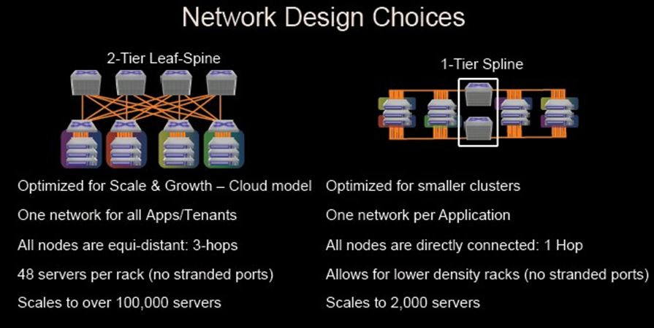
Deliverable 2: Device Hardening
Many common programming issues during the development cycle of a new technology have been caught.
The following list provides some examples of fundamental design choices that form part of Arista's software design process:
Safe language choices
Highly audited libraries usage
Resource leakage prevention
Pipelined execution models around single threaded functions to avoid deadlocks
Principles of least privileged
Strong input sanitization(internal/external API's)
Memory Safe VMs
Model of Arista's Design Choices for Large Enterprises

Slide 17
Deliverable 2: Device Hardening
How does Arista raise awareness to prevent these common hard code mistakes with development stage of their innovation?
Engineers are trained on securing code practices and how to implement it in their code. They are trained to distinguish from secure to insecure code designs.
The usage of security critical open-source libraries is limited to a few well understood libraries. This serves to limit the surface of the attack as well as make analyzing the usage of said libraries in the codebase easier.
Maintain dialogue open within the company and constantly reviewing common attack vectors

Slide 18

Deliverable 3: Vulnerability Management: Assessing and Treating Risks
1. Design choices for vulnerability avoidance- Arista's product family are all designed with safe execution in mind.
Safe language choices, ensuring mitigation against common flaws like buffer overflow and other memory management issues
Prevention of resource leakage with safe memory operations, like bounds checking, reference conditions and deadlocks
Strong input sanitization for internal and external APIs, preventing malformed data injection
Principle of least privilege to limit permissions given to processes and users
2. Vulnerability Detection- tools, processes, testing procedures Arista undertakes for awareness of emerging vulnerabilities.
Arista has an automated CVE scanner process which works by automatically downloading the database of known issues from the NVD and cross-checking versions of each vulnerability against versions of shipped code in releases that have not reached EOL.
PSIRT engineers conduct ongoing and detailed security reviews of Arista's written code base to check for issues.
Every security issues is identified for severity and potential impact
Arista has an open line of communication with it's third-party vendors, and any vulnerabilities they may have will be discussed with the Arista's PSIRT team.

Slide 19
Deliverable 3: Vulnerability Management: Assessing and Treating Risks
3. Vulnerability Communication- new vulnerabilities are made available as soon as possible via well-known procedures.
- If an issue impacts Arista products, a solution will be provided, which will provide procedures to fix a vulnerability, such as a configuration change or software patch.
- Details of the vulnerability and solutions are documented publicly via a security advisory on the Arista website.
- Arista follows best practices to making CVEs findable, by having all CVEs assigned by MITRE so issues can be efficiently tracked across security scanners, advisories, and other security management procedures.

Slide 20
Delivery 4: Taking Security Measures
What is the security measure taken?
Arista’s Zero Trust Cloud Networking is based upon three foundational concepts:
1.Situational Awareness, the visibility of all assets and workloads, Enforcement, restricting access to required connections, and Continuous Monitoring – never trust and continually verify. Arista leverages many tools that help them successfully and continually execute this zero-trust policy, keeping their cloud networking operations secure and functional.
What security tools does it integrate?
Cloud network vision automation
Telemetry
Arista Network Detection Response Platform
Arista DANZ Monitoring Fabric
If they encounter issues with these tools, they make use of zero-trust portfolio which provides real-time visibility to the threat posture across the network, with the ability to take immediate action.

Slide 21
Delivery 4: Taking Security Measures
What are the capability of the security tools Arista ZERO-Trust Policy utilizing?
Cloud vision provides a nicely configured GUI, which provides a simple compliance dashboard that reports observed PSIRT security advisories within a network, as well as any known exposures to software defects that are relevant, and out-of-band non-sanctioned changes made to switches under management.
Arista NDR is built upon a foundation of deep network analysis across campus, data center, IoT, and cloud workload networks. As opposed to other NDR solutions, Arista NDR parses a little over three thousand protocols and processes, including layer 2 through layer 7 data, while performing encrypted traffic analysis.
For threat detection, Arista NDR incorporates Adversarial Modeling enabling autonomous threat hunting for complex attacker tactics, techniques, and procedures (TTP).
Arista AVA (Autonomous Virtual Assist) is the world’s first AI- based security expert system, which performs autonomous threat hunting and incident triage. It uses artificial intelligence, open-source intelligence, and human expertise to connect the dots across dimensions of time, entities, and protocols, which enables the solution to present end-to-end situations to the end-user.
DMF is a next generation NPB (Network Packet Broker) which is designed for pervasive, organization-wide visibility and security, enabling IT operators to pervasively monitor and mirror all traffic, while providing deep hop-by-hop visibility, predictive analysis, and scale-out packet capture.

Slide 22

PROFESSIONAL ACCOMPLISHMENTS
What did we learn?
gain a deep understanding of the ways a network company implicates network theory and strategies it takes to manage vulnerabilities.
The hacker attacks are becoming more sophisticated every day and that's why keeping your employees up to their feet with security training is vital. A company loses tons of money from the damages an attack can due to their systems.
the process Arista takes to protect their systems and realized how cloud networking is strongly appreciated for protecting the confidentiality, integrity, and availability of their cloud networking technologies, which makes up most of their company.
What were the challenges we had to overcome?
Company transparency made research part of the project easy but, due to all the information we retrieved we had a hard time deciding which piece would be more relevant to the milestones and deliverables.

Slide 23
References
[1] Arista Networks Inc. (2021, October 22). The arista way: Practicing and cherishing our ongoing culture. Retrieved November 22, 2022, from https://www.arista.com/assets/data/pdf/TheAristaWay.pdf
[2] Arista Networks Inc. (2021, October 22). Arista Networks Corporate Responsibility Report. Retrieved November 22, 2022, from https://www.arista.com/assets/data/pdf/Arista_CRR_2021.pdf
[3] Arista Networks. (2022, May 11). Corporate responsibility. Arista Networks. Retrieved November 22, 2022,from https://www.arista.com/en/company/corporate-responsibility/environment
[4] Www.arista.com. (2020, March 4). Retrieved November 24, 2022,from https://www.arista.com/assets/data/pdf/Whitepapers/White-Paper-Employee-Training-Cybersecurity-101.pdf
[5] Arista Networks. (2022). Arista zero trust security for cloud networking [White paper]. Retrieved November 15, 2022, from Arista Networks: https://www.arista.com/assets/data/pdf/Whitepapers/Arista-Zero-Trust-Security-for-Networking.pdf
[6] Arista Networks. (2021, October 6). Device hardening and vulnerability management - arista. Arista Networks. Retrieved November 16, 2022, from https://www.arista.com/en/support/product-documentation/vulnerabilitymanagement
[7] Arista Networks, Inc. partner code of ethics and business conduct. (2022). Retrieved November 27, 2022, from https://www.arista.com/assets/data/pdf/Arista-Partner-Code-of-Ethics-and-Business-Conduct.pdf [9] Bayshore Arista Solution Guide. (2021). Retrieved November 27, 2022, from https://www.arista.com/assets/data/pdf/JointPapers/Bayshore-Arista-Solution-Guide.pdf

Slide 24

Q&A
Thank you very much for your attention!

